Slide 1

Geometry
Unit 1, Lesson 11 Perpendicular Bisectors Volume 1, pg. 69

Slide 2


Benchmarks
MA.912.GR.1.1
Prove relationships and theorems about lines and angles. Solve mathematical and real-world problems involving postulates, relationships, and theorems of lines and angles.
MA.912.GR.5.2
Construct the bisector of a segment or an angle, including the perpendicular bisector of a line segment.
volume 1, pg. 69

Slide 3
Integrated Mathematical Thinking and Reasoning Standards
MA.K12.MTR.2.1 Demonstrate understanding by representing problems in multiple ways.
volume 1, pg. 69

Slide 4

Learning Targets
I can construct a perpendicular bisector.
I can use rigid transformations to show that any triangle formed by drawing two segments from the endpoints of a segment to a point on its perpendicular bisector is isosceles.
I can use the properties of a perpendicular bisector to solve problems.
volume 1, pg. 69

Slide 5

Warm-Up
volume 1, pg. 69

Slide 6
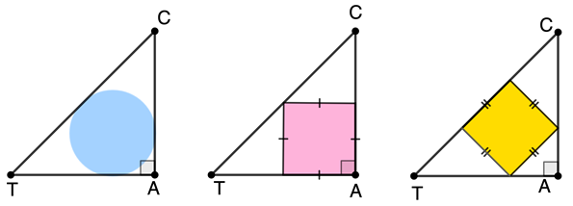

1.11.1 Warm-Up: Compare Areas
$∆CAT$ is an isosceles right triangle.
Which inscribed figure has the greatest area? Justify your choice.
volume 1, pg. 69

Slide 7

Exploration
volume 1, pg. 70

Slide 8

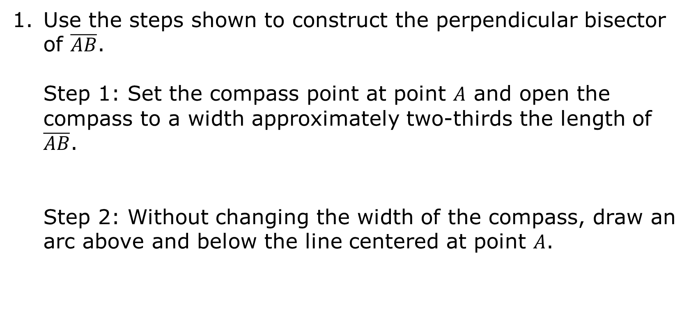
1.11.2 Exploration: Constructing Perpendicular Bisectors
Use the steps shown to construct the perpendicular bisector of $\overline{AB}$.
Step 1: Set the compass point at point $A$ and open the compass to a width approximately two-thirds the length of $\overline{AB}$.
Step 2: Without changing the width of the compass, draw an arc above and below the line centered at point $A$.
volume 1, pg. 70

Slide 9
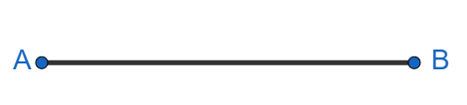
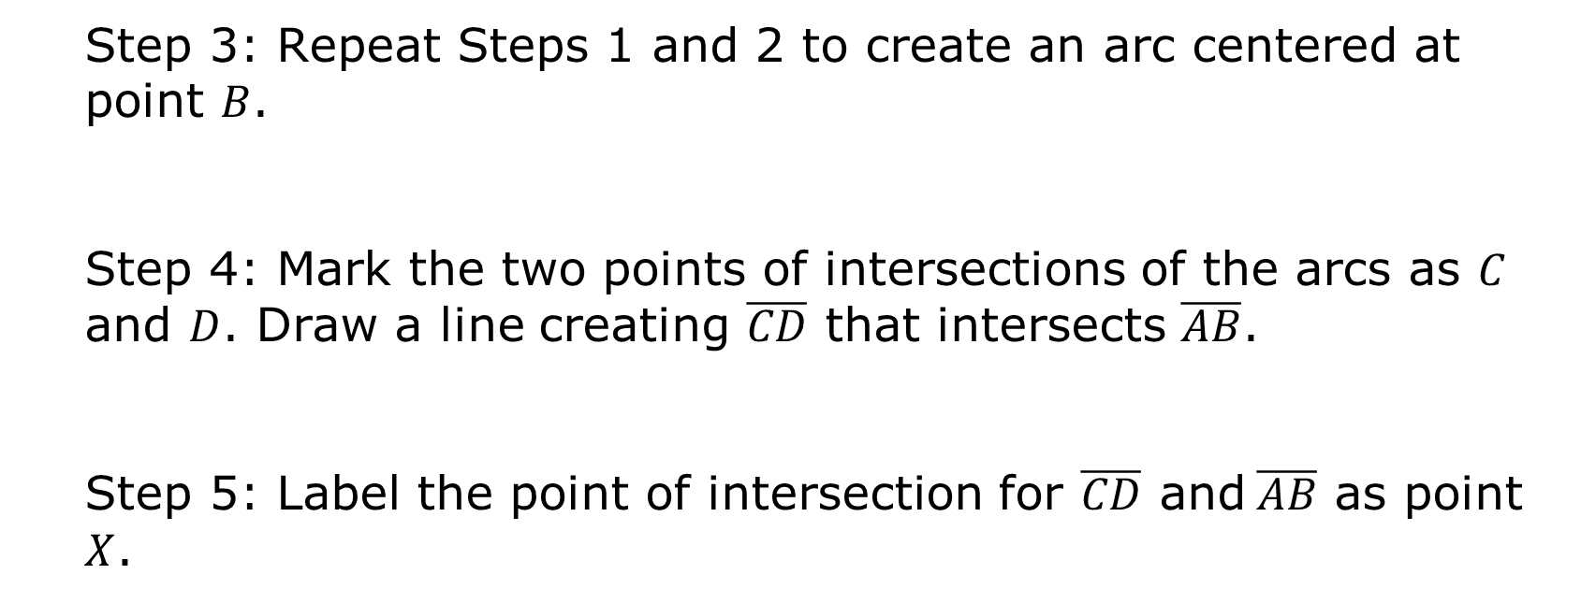
Step 3: Repeat Steps 1 and 2 to create an arc centered at point $B$.
Step 4: Mark the two points of intersections of the arcs as $C$ and $D$. Draw a line creating $\overline{CD}$ that intersects $\overline{AB}$.
Step 5: Label the point of intersection for $\overline{CD} \text{and} \overline{AB}$ as point $X$.
volume 1, pg. 70

Slide 10
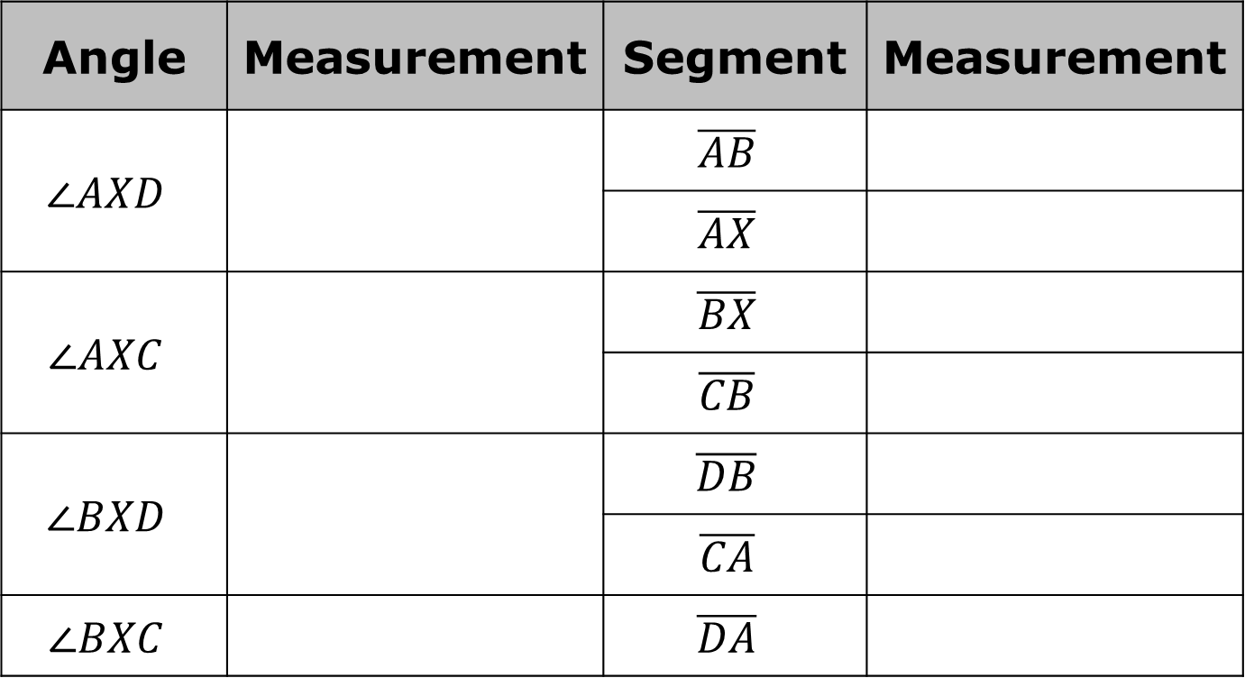
Use a protractor and ruler to find each of the measurements.
Angle | Measurement | Segment | Measurement
$$∠AXD$$ |  | $$\overline{AB}$$
 |  | $$\overline{AX}$$
$$∠AXC$$ |  | $$\overline{BX}$$
 |  | $$\overline{CB}$$
$$∠BXD$$ |  | $$\overline{DB}$$
 |  | $$\overline{CA}$$
$$∠BXC$$ |  | $$\overline{DA}$$
volume 1, pg. 71

Slide 11
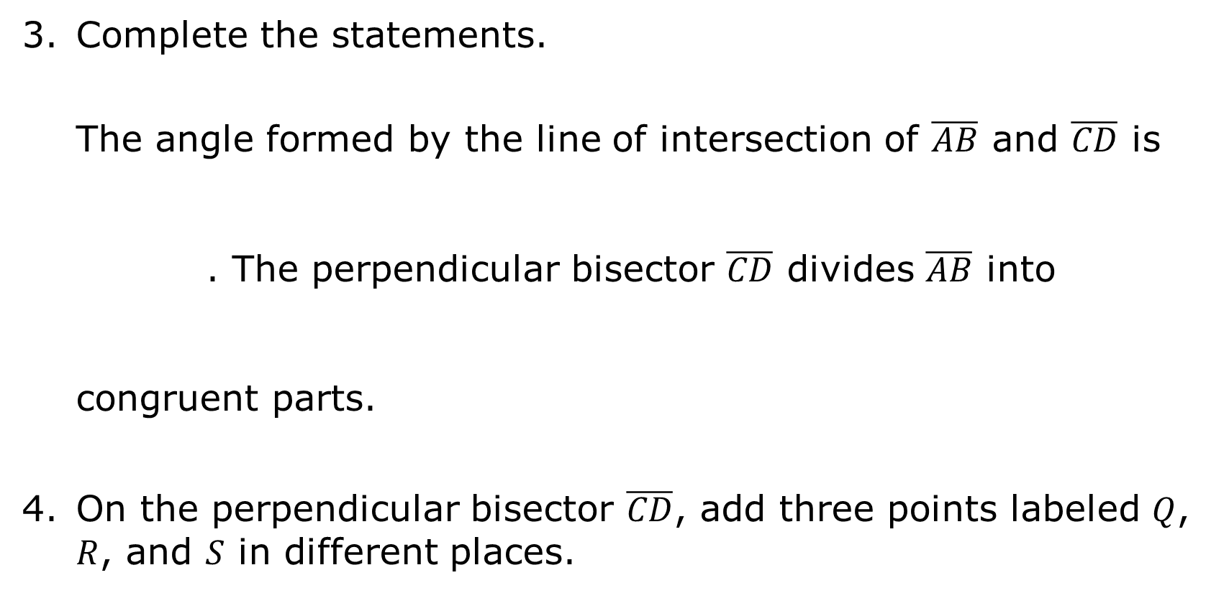
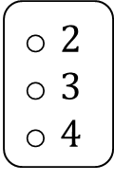
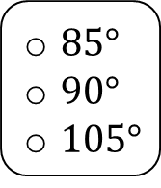
Complete the statements.
The angle formed by the line of intersection of $\overline{AB}$ and $\overline{CD}$ is . The perpendicular bisector $\overline{CD}$ divides $\overline{AB}$ into congruent parts.
On the perpendicular bisector $\overline{CD}$, add three points labeled $Q$, $R$, and $S$ in different places.
$85°$
$90°$
$105°$
$2$
$3$
$4$
volume 1, pg. 71

Slide 12
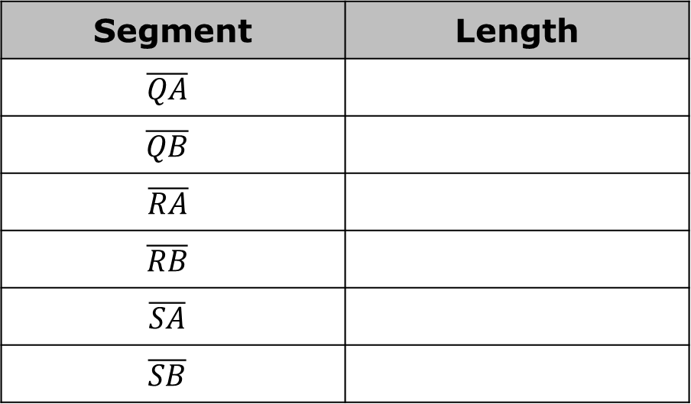
Using a ruler, measure the length of each line segment.
Write a conjecture about the endpoints of a line segment and any point on its perpendicular bisector.
Segment | Length
$$\overline{QA}$$
$$\overline{QB}$$
$$\overline{RA}$$
$$\overline{RB}$$
$$\overline{SA}$$
$$\overline{SB}$$
volume 1, pg. 71

Slide 13
Share your conjecture with a partner. Summarize your partner’s conjecture and have them initial that your summary is correct.
Partner’s Conjecture | Partner’s Initials
volume 1, pg. 71

Slide 14

Activity
volume 1, pg. 72

Slide 15

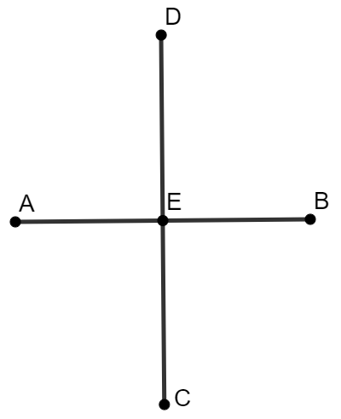

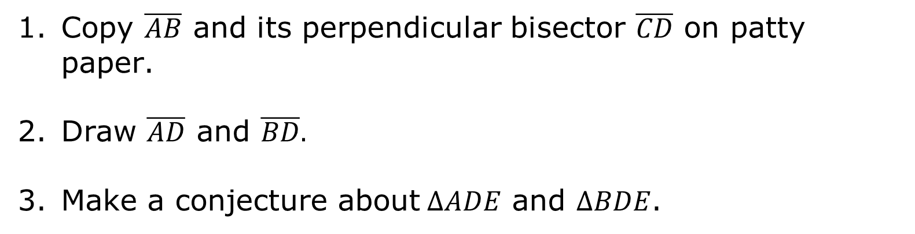
1.11.3 Activity: Perpendicular Bisectors and Triangles
Copy $\overline{AB}$ and its perpendicular bisector $\overline{CD}$ on patty paper.
Draw $\overline{AD}$ and $\overline{BD}.$
Make a conjecture about$∆ADE$ and $∆BDE$.
A right triangle is a triangle containing an interior right angle.
volume 1, pg. 72

Slide 16

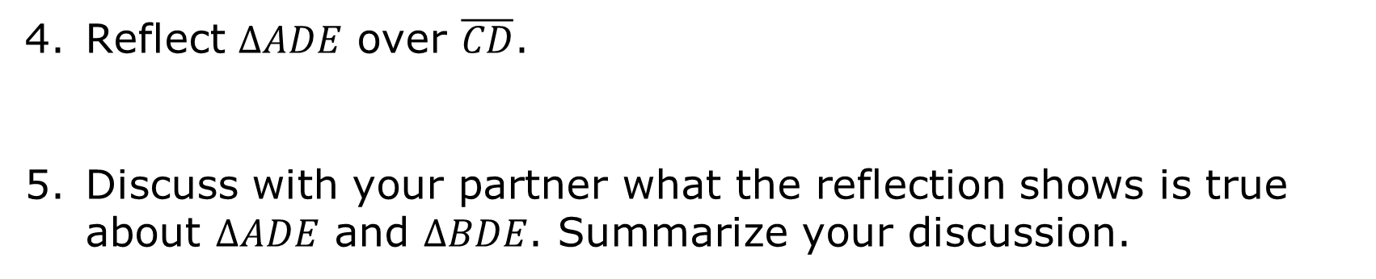
Reflect $∆ADE$ over $\overline{CD}$.
Discuss with your partner what the reflection shows is true about $∆ADE$ and $∆BDE$. Summarize your discussion.
An isosceles triangle contains at least two equal length sides and two equal interior angle measures.
volume 1, pg. 72

Slide 17
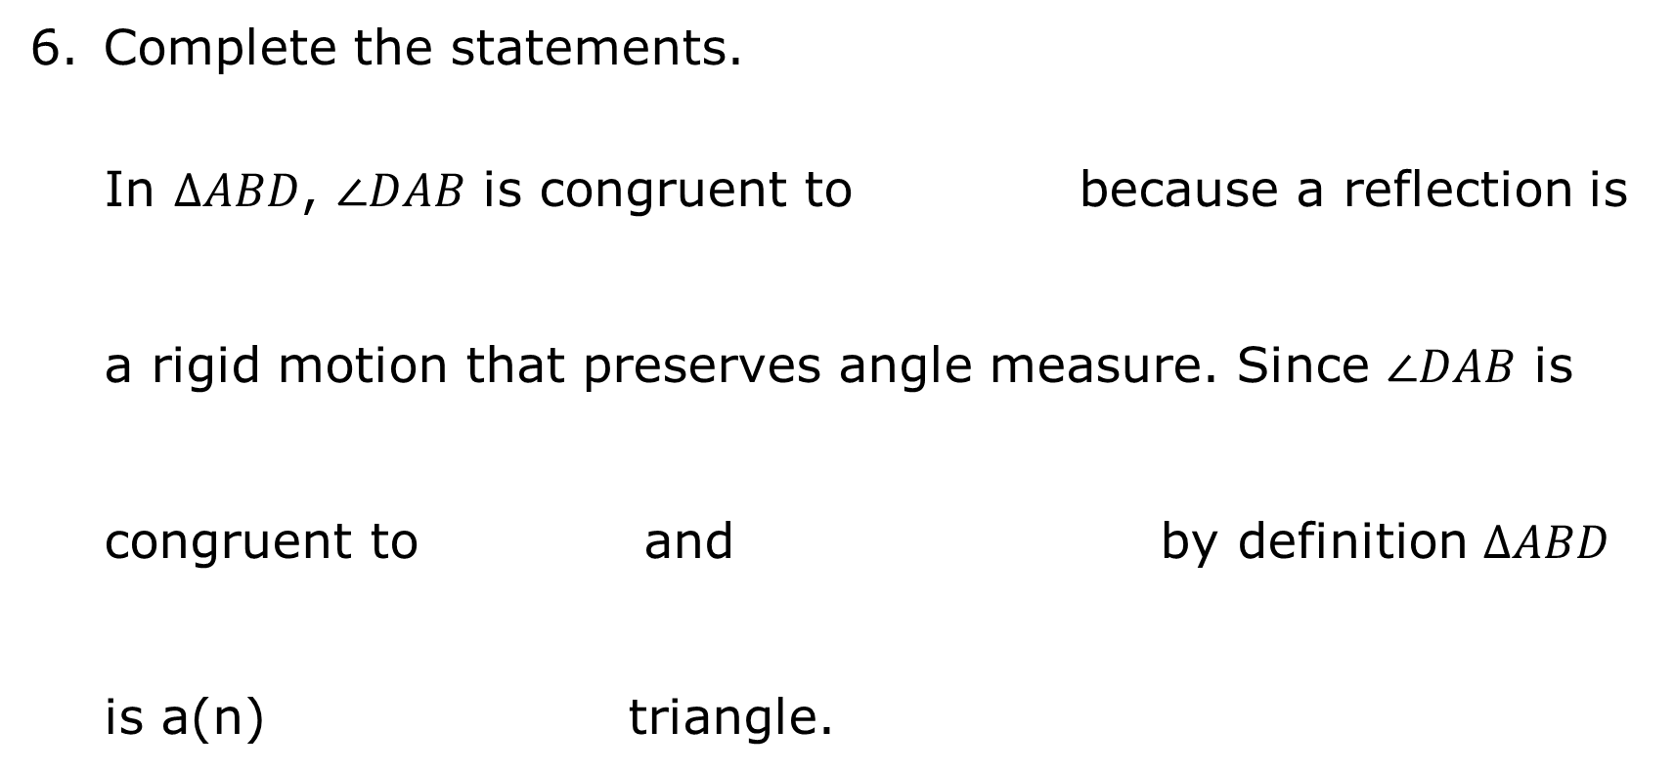

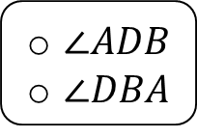
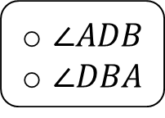
Complete the statements.
In $ΔABD$, $∠DAB$ is congruent to because a reflection is a rigid motion that preserves angle measure. Since $∠DAB$ is congruent to and by definition $ΔABD$ is a(n) triangle.
$∠ADB$
$∠DBA$
$\overline{AD}≅\overline{AB}$,
$\overline{AD}≅\overline{BD}$,
$\overline{AE}≅\overline{BE}$,
None of these
$∠ADB$
$∠DBA$
scalene
isosceles
equilateral
volume 1, pg. 72

Slide 18

Bring It Together
volume 1, pg. 73

Slide 19


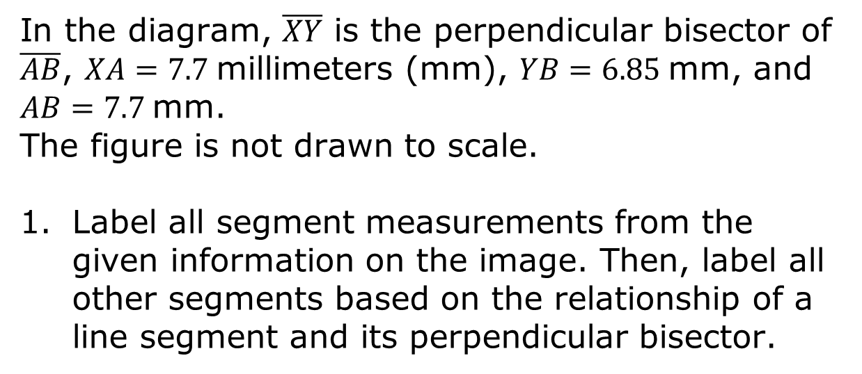
1.11.4 Bring It Together: Perpendicular Bisectors and Triangles
If a point is on the perpendicular bisector of a line segment, then it is equidistant from the endpoints of the line segment.
In the diagram, $\overline{XY}$ is the perpendicular bisector of $\overline{AB}$, $XA=7.7$millimeters (mm), $YB=6.85$mm, and $AB=7.7$mm. The figure is not drawn to scale.
Label all segment measurements from the given information on the image. Then, label all other segments based on the relationship of a line segment and its perpendicular bisector.
volume 1, pg. 73

Slide 20

Given $\overline{XY}$ is the perpendicular bisector of $\overline{AB}$, label all of the congruent angles.
The triangle formed by a line segment and two segments drawn from the endpoints of the segment to a point on the perpendicular bisector of the segment is an isosceles triangle.
volume 1, pg. 73

Slide 21

Guided Practice
volume 1, pg. 73

Slide 22

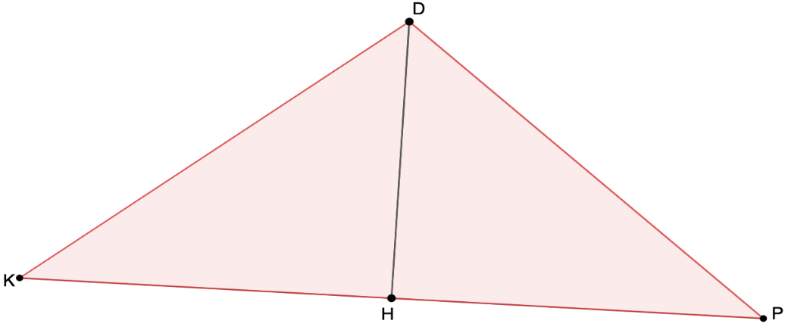

1.11.5 Guided Practice: Perpendicular Bisectors
1. $\overline{DH}$ is the perpendicular bisector of $\overline{KP}$, where $KD=−x−1$ and $PD=−\frac{x}{2}+19$.
What is the value of $x$?
What is the length of $\overline{KD}$?
volume 1, pg. 73

Slide 23

Your Turn
volume 1, pg. 74

Slide 24
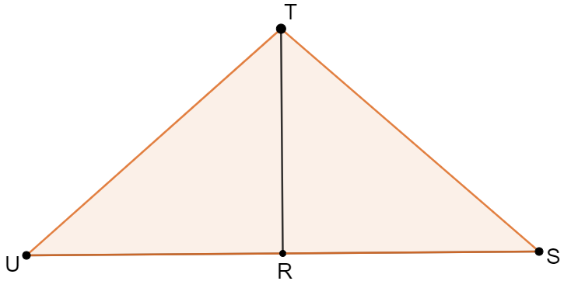
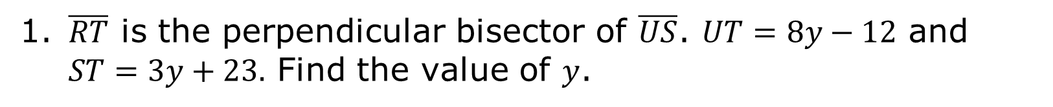
1.11.6 Your Turn!
1. $\overline{RT}$ is the perpendicular bisector of $\overline{US}$. $UT=8y−12$ and $ST=3y+23.$ Find the value of $y$.
volume 1, pg. 74

Slide 25




Describe the error that was made in the construction of a perpendicular bisector.
$$A$$
$$B$$
$$C$$
$$D$$
volume 1, pg. 74

Slide 26

Wrap-Up
volume 1, pg. 74

Slide 27
1.11.7 Wrap-Up: Cool Down
Write a summary of what you learned in this lesson.
volume 1, pg. 74

